Slide 1
Session 2: data manipulation and plotting
Import and explore data: using “readxl” package
Subset data: using “dplyr” package
Order data: function order()
Merge data: function merge()
Calculate mean and sd
Export data: using “openxl” package
Plot data: using “ggplot2” package (scatter, box, bar plots)

Slide 2
Excel or R
R is more flexible for figure generation or figure standardization
Some data can only be processed by R, with specific packages
You need to put effort and time to start using R
R is an alternative (not the only) way to process your data
Combing excel and R
You are free to use any other tools that you master

Slide 3
Basic statistics
Yujia Luo
Session 3

Slide 4

Statistics
Abstract concepts
Complicated formulas
Restrictions

Slide 5
Statistics
Don’t overlook the results of statistics
Trust your common-sense
Advanced statistics cannot overcome basic design flaws
In practice, you don’t need to understands all the formulas (need to know the restriction)

Slide 6
Aim
Using R to explore:
Relationship between response y and treatment factor x (regression)
Difference in response between treatments (ANOVA, t-tests)

Slide 7
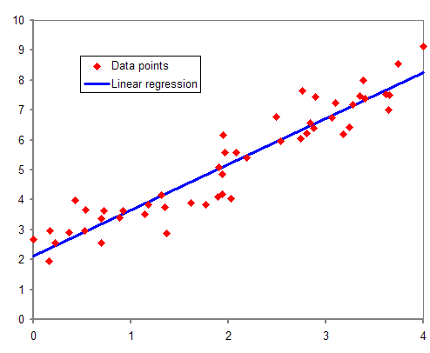
Linear regression

Slide 8
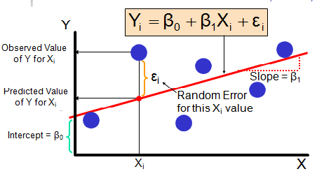
Linear regression
Y_{i} = Systematic part + Random part (unexplained)
Restrictions:
Y_{i} ~ N(𝝁, 𝝈²)
Ɛ_{i} ~ N(0, 𝝈²)
Homogeneity of variance
Notes:
Homogeneity means that the variance among the groups should be approximately equal.

Slide 9
Least squares estimation
Predicted value: Y’ = 𝝱0 + 𝝱1*X
Realized value (we meaure): Y
Residule: r = Y – Y’
Least squares estimation: sum of squared residuals (SS) should be as small as possible → find out the values of 𝝱0 and 𝝱1

Slide 10
Practice in R
Is height of plant related to final seed yield?
10 observations:
Height of plant (cm): 45, 52, 42, 35, 40, 48, 60, 61, 50, 33
Yield (g): 12.2, 12.4, 11.9, 11.3, 11.8, 12.1, 13.1, 12.7, 12.4, 11.4
DF: degree of freedom (DF = n -1)
Notes:
Degrees of freedom refers to the maximum number of logically independent values, which are values that have the freedom to vary, in the data sample

Slide 11
T-test and ANOVA (F-test)
T-test: difference between two levels of an experimental factor
Difference in bacterial biomass between low and high N dose
ANOVA (Analysis of variance): difference between more than two levels
Difference in bacterial biomass among low, median, and high N dose

Slide 12

One-way ANOVA (F-test)
One experimental factor
5 treatments on soil pH, each treatment has 6 replicates (n = 30)
Test null hypothesis: 𝝁1 = 𝝁2 = 𝝁3 = 𝝁4 = 𝝁5
F-test: F=
SSA: sum of squares for factor
SSE: sum of squares for error/residue
SST = SSA + SSE
if we have t groups (t -1 = 4), and in total 𝑛 observations (n - 5 = 25)
$$\frac{SSA/(t−1)}{SSE/(n−t)}$$

Slide 13
Two-way ANOVA, three-way ANOVA
Two experimental factor, three experimental factors
Nitrogen dose and light intensity → wheat growth
Nitrogen dose, temperature, and light intensity → wheat growth

Slide 14
> 3 experimental factors
multivariate analysis (advanced statistics, PCA, PCoA, RDA)

Slide 15
Practice in R
Effects of two organic amendments with different doses on soil chemical properties (pH, WC, N…)
Organic amendments: compost and bokashi
Application dose: high and low

Slide 16
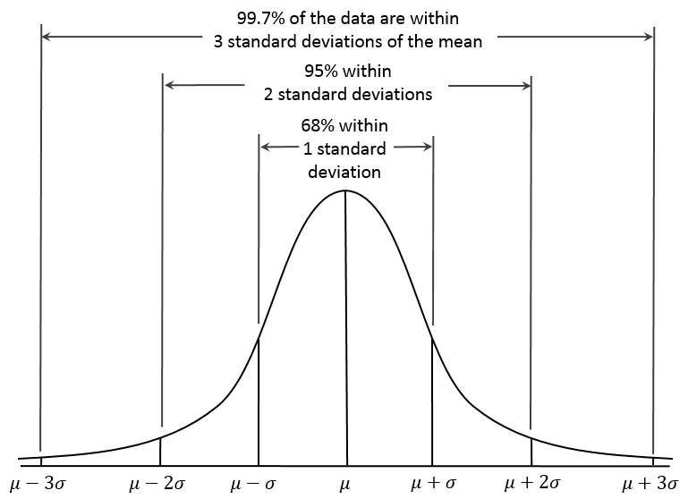
Normal distribution Y ~ N(µ₁, 𝜎²)
normal distribution with mean µ₁ and variance 𝜎²

Slide 17
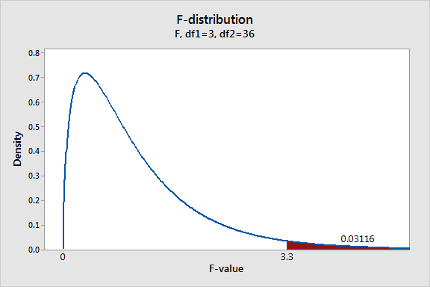

One-way ANOVA
One experimental factor
Nitrogen dose on wheat height (if N dose has 4 levels)
Test null hypothesis: 𝝁1 = 𝝁2 = 𝝁3 = 𝝁4
F-test: F=
if we have t groups (t = 4), and in total 𝑛 observations (n = 40)
$$\frac{SSbetween/(t−1)}{SSwithin/(n−t)}$$

Slide 18
T-test and ANOVA
Linear regression model: Y’ = 𝝱0 + 𝝱1*X + Ɛ (X is a dumy variable, 0 or 1)
Two reactors A and B; compare bacterial biomass in two reactors
Reactor A: X = 0
Reactor B: X = 1
𝝱0 is the predicted biomass of Reactor A
𝝱1 is the predicted biomass difference between two reactors
Null hypothesis:
𝝁1 = 𝝁2

